Slide 1
CliQue
Clustering Algorithm

Slide 2
Overview
Introduction
Working of CliQue Clustering
Example
Advantages of CliQue Clustering
Disadvantages of CliQue Clustering

Slide 3
Introduction
CLIQUE is a density-based and grid-based subspace clustering algorithm
  Grid-based: It discretizes the data space through a grid and estimates the density by counting the number of points in a grid cell.
  Density-based: A cluster is a maximal set of connected dense units in a subspace.
A unit is dense if the fraction of total data points contained in the unit exceeds the input model parameter
● Subspace clustering: A subspace cluster is a set of neighboring dense cells in an arbitrary subspace. It also discovers some minimal descriptions of the clusters
● It automatically identifies subspaces of a high dimensional data space that allow better clustering than original space using the Apriori principle

Slide 4
Working of Clique Clustering
It is a 2-Step process
It partitions the n-dimensional data space into non-overlapping
rectangular units.
2. Generates minimal description of each cluster

Slide 5
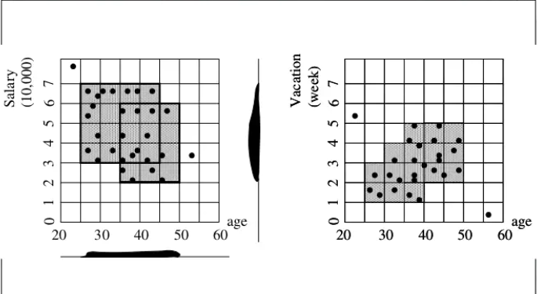
Step 1
CLIQUE partitions each subspace that has dimension 1 into the same number of equal length intervals.
Using this as basis, it partitions the n-dimensional data space into non-overlapping rectangular units.

Slide 6
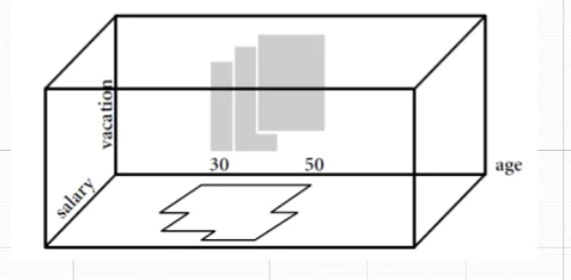
Intersection of Dense Units
Dense units found with respect to age for the dimensions salary and vacation are intersected in order to provide a candidate search space for dense units of higher dimensionality.

Slide 7
Step 2
For each cluster, Clique determines the maximal region that covers the cluster of connected dense units.
• It then determines a minimal cover (logic description) for each cluster.

Slide 8
CLIQUE: The Major Steps
Partition the data space and find the number of points that lie inside each cell of the partition.
Identify the subspaces that contain clusters using the Apriori principle
Identify clusters:
Determine dense units in all subspaces of interests
Determine connected dense units in all subspaces of interests.
• Generate minimal description for the clusters
Determine maximal regions that cover a cluster of connected dense units for each cluster
Determination of minimal cover for each cluster

Slide 9
Advantages
It automatically finds subspaces of the highest dimensionality such that high density clusters exist in those subspaces.
It is quite efficient.
It is insensitive to the order of records in input and does not presume some canonical data distribution.
It scales linearly with the size of input and has good scalability as the number of dimensions in the data increases.

Slide 10
Disadvantages
The accuracy of the clustering result may be degraded at the expense of simplicity of the simplicity of this method.

Slide 11
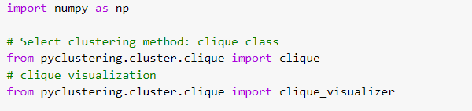
Implementation
It is Implemented by Pyclustering Module using Python
Algorithm core tuning parameters: grid step size, and density threshold.
Import the required modules:

Slide 12
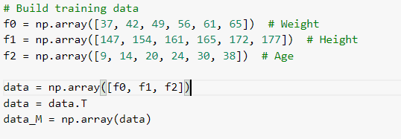
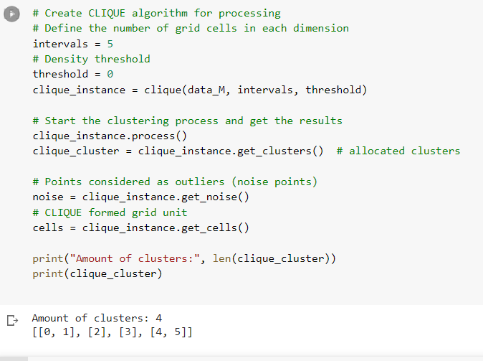
.
Construct the data to be clustered:
Use clique clustering method to cluster:

Slide 13
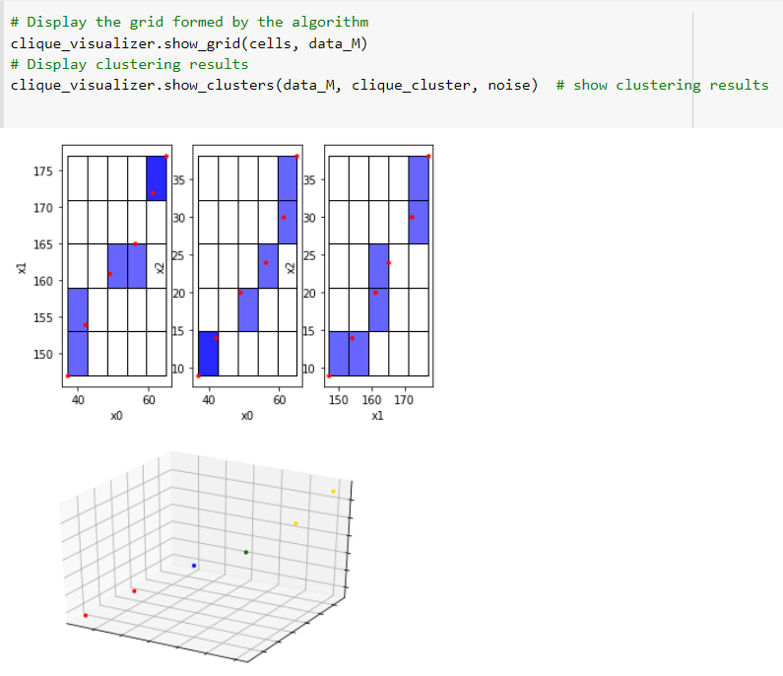
.
Visualization of clustering results:

